Slide 1
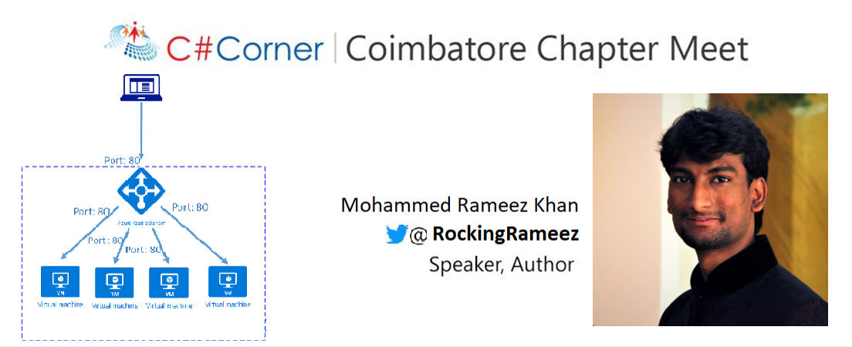
Load Balancing on Azure
#CSharpCorner @RockingRameez | @CodeSizzler

Slide 2
Agenda:
About Load Balancing on Azure
Hands on with Load Balancing
#CSharpCorner @ RockingRameez | @CodeSizzler

Slide 3
Why Load Balancing ?
Load Balancing on your servers
#CSharpCorner @ RockingRameez | @CodeSizzler

Slide 4
Links for documents –
#CSharpCorner @ RockingRameez | @CodeSizzler

Slide 5
Hands on – Load Balancing on Azure
#CSharpCorner @ RockingRameez | @CodeSizzler

Slide 6

Thanks for joining us!!
Mohammed Rameez Khan
Feel free to reach me for any queries:
@RockingRameez | @CodeSizzler
md.Rameez.khan24@outlook.com
#CSharpCorner @RockingRameez | @CodeSizzler

